Slide 1
Data Structure Algorithms
Section 1 - introduction

Slide 2
What is Data Structure
- Data Structure: Is a way to 'organize data' in a way that enables it to be
processed in an efficient time.
Some of the common Data Structure (DS) are:
- Array
- Linked List
- Stack
- Queue
- Tree
- Hashing
- Graph etc.

Slide 3
What is Algorithm ?
Algorithm: Is a set of rules to be followed to solve a problem.
Example: Let's say we want to prepare some home made salads for Dinner.
1) We have a basket all fruits and vegetables mixed (disorganized).
2) We use Data Structure to organize the vegetables and fruits in the basket.
3) We clean all fruits and vegetables.
4) We cut all of them
5) We have to do the trace part.
6) Finally we are ready for all dinner.
Steps 3, 4, 5 we set of rules to solve the problem.

Slide 4
Why companies ask Data Structure & Algorithm in interview?
Answer: You are good solver problem or not?
They check 'Problem Solving skills'
They check 'Coding/Testing skills’
Second Part Interview
They check our code skills.
How are we handling those corner cases which typically can break in production.

Slide 5
Which companies ask Data Structure & Algo in interview ?
- Product based company - Approximately 80% of their interview will be focused
on DS.
- Microsoft
- Google
- Facebook
- Service based company - They don't emphasizes much on DS(as they want quick
solution). Still one can expected 1-2 questions on simple DS.
- TATA
- Accenture
- Cognizant

Slide 6
Data Structure In Every Day Life
Example#1 - Use of Data Structures in Non-Computing Fields:
- Queue: Fans assembled for Autograph.
- Make a queue to take a photo
- Tree: Is used normally for: Parent-Child relationship/Generalization-Specialization
"WhiteFox is child of Todd and Diamond Sequoia is child of Redwood and Sally Kestrel
is child of WhiteFox and Sequoia"
Who's Todd Grand-child?
It is really complicated answer this question based on the above text. Better solution
is organize the information as a Tree.

Slide 7
Data Structure In Every Day Life
Example #3
Graph: Shortest route from one city to another city:

Slide 8
Types of Data Structure Data Structure can be divided into two categories that is primitive data structure.
Types of Data Structure
|
|
--------------------------------------------------------------------------------
| |
| |
Primitive DS Non-Primitive DS
| |
----------------------------------- ---------------------------------------------
| | | | | | |
Integer Float Character Boolean Physical DS Logical DS
| |
---------------- --------------------------------
| | | | | |
Array Linked List Stack Queue Tree Graph

Slide 9
Data Structure Algorithms
Section 2 - Recursion

Slide 10
What is 'Recursion'?
Properties of Recursion:
- Same operation is performed multiple times with different inputs.
- In every step we try to make the problem smaller.
- We mandatorily need to have a base condition, which tells system when to
stop the recursion.

Slide 11
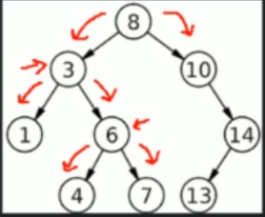
What is 'Recursion'?
Example from Computing World: Let's say we want to search for value '4' in bellow
Tree.
search (root, valueToSearch)
if (root equals null) return null
else if (root.value equals valueToSearch) return root
else if (valueToSearch < root.value) search(root.left, valueToSearch)
else search (root.right, valueToSearch)

Slide 12
Why should we learn 'Recursion'
- Because it makes the code easy to write (compared to 'iterative') whenever a
given problem can be broken down into similar sub-problem.
- Because it is heavily used in Data Structures like Tree, Graphs, etc.
- It is heavily used in techniques like "Divide and Conquer", "Greedy", "Dynamic
Programming".
Note: * Iterative - Loop
Note: Similar sub-problem are in subsequent video.

Slide 13
Format of a 'Recursive Function'
- Recursive Case: Case where the function recur.
- Base Case: Case where the function does not recur.
Example:
SampleRecursion(parameter){
if (base case is satisfied)
return some base case value
else
SampleRecursion(modified parameter)
}

Slide 14
How 'Recursion' works internally ?
Main()
Bar();
System.out.println("I am in Main");
Bar()
DoWork()
System.out.println("I am in Bar");
DoWork()
DoMore()
System.out.println("I am in DoWork")
DoMore(){
System.out.println("I am in DoMore")
}

Slide 15
How 'Recursion' works internally ?
STACK works using LIFO method that means: Last in First Out.
e.i:
If I add in the stack: 3,2,1. The last input was 1 but What if I try to access
the number 3 I have to access first 1 after 2 then number 3. (LIFO)
More deeply watch the Stack Chapter.

Slide 16
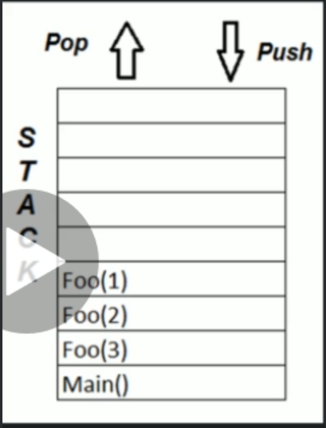
How 'Recursion' works internally ?
foo(n){
if(n<1)
return
else
foo(n-1)
print "Hello World" + n
}
Main(){
foo(3)
}

Slide 17
How 'Recursion' works internally ?
Factorial:
Definition
- Factorial of a non-negative integer n
- denoted by n!
- is the product of all positive integers from 1 to n.
Example:
5! = 5*4*3*2*1 = 120
10! = 10*9*8*7*6*5*4*3*2*1 = 36,28,800

Slide 18
How 'Recursion' works internally ?
Fibonacci Series:
Definition
- A series of numbers in which each number is the sum of the two preceding
numbers.
- First 2 numbers by definition are 0 and 1.
Example: 0,1,1,2,3,5,8,13,21,34,55,89,144, ...
fib(n)
if n is less than 1
return error message
else if n is equal to 1 or 2
return n-1
return fib(n-1) + fib(n-2);

Slide 19
How 'Recursion' works internally ?
Recursion vs Iteration
Particulars Recursion Iteration
Space efficient? No Yes
Time efficient? No Yes
Ease of code (to solve sub-problems) Yes No

Slide 20
When to use / Avoid Recursion?
When to use:
- When we can easy breakdown a problem into similar subproblem##
- When we are ok with extra overhead (both time and space) that comes with it.
- When we need a quick working solution instead of efficient one.
When not to use:
if the response to any of the above statements is NO, we should not go with
recursion.

Slide 21
Practical use of 'Recursion'
- Stack
- Tree - Traversal/Searching/InsertionDeletion
- Sorting - Quick Sort, Merge Sort
- Divide and Conquer
- Dynamic Programming
- Etc.

Slide 22
What & Why of 'Algorithm Run Time Analysis'
What is 'Algo Run Time Analysis'?
- It is a study of a given algorithm's running time, by identifying its behavior
as the input size for the algorithm increases. In a layman's language we can
say, 'how much time will the given algorithm will take to run'.
Why should we learn this?
- To measure 'efficiency' of a given algorithm.
- If we don't learn this topic, this is our program would look like.

Slide 23
Notations for 'Algo Run Time Analysis'
-How much does this car runs on 1 litre of petrol?
- In City traffic? 10km/h
- On highway? 20km/h
- Mixed environment? 15km/h
Depends on the environment the car can consume more or less.

Slide 24
- There are 3 notations for 'Run Time Analysis'
- Omega
- This notation gives the tighter lower bound of given algorithm.
- In a layman's language we can say that for any given input, running Time
of a given algorithm will not be 'less than' given time.
- Big-o(O)
- This Notation gives the tighter upper bound of a given algorithm.
- In a layman's language we can say that for any given input, running
time of a given algorithm will not be 'more than' given time.
- Theta(0):
- This Notation decides whether upper bound and lower bound of a given
algorithm are same or not.
- In a layman's language we can say that for any given input, running
time of a given algorithm will 'on an average' be equal to given time.

Slide 25
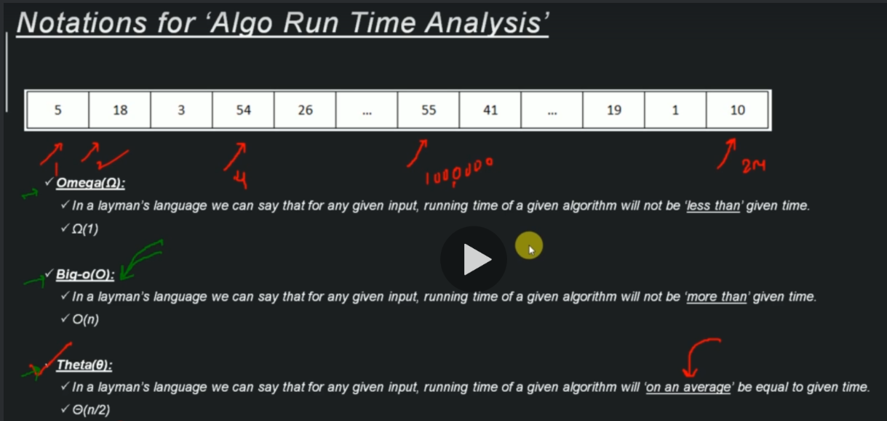
- There are 3 notations for 'Run Time Analysis'

Slide 26
Examples of 'Algorithm run time complexities'
Time Complexity | Name | Example
O(1) | Constant | Adding and element at from of linked list
O(log n) | Logarithmic | Finding an element in sorted array
O(n) | Linear | Finding an element in unsorted array.
O(n logn) | Linear Logarithmic | Merge Sort
O(n^2) | Quadratic | Sortest path between 2 nodes in a graph
O(n^3) | Cubic | Matrix Multiplication
O(2^n) | Exponential | Tower of Hanoi Problem
The table above show the complexity and time consume.
Note: Open the picture S02-L04-ExamplesOfTimeComplexity.pgn

Slide 27
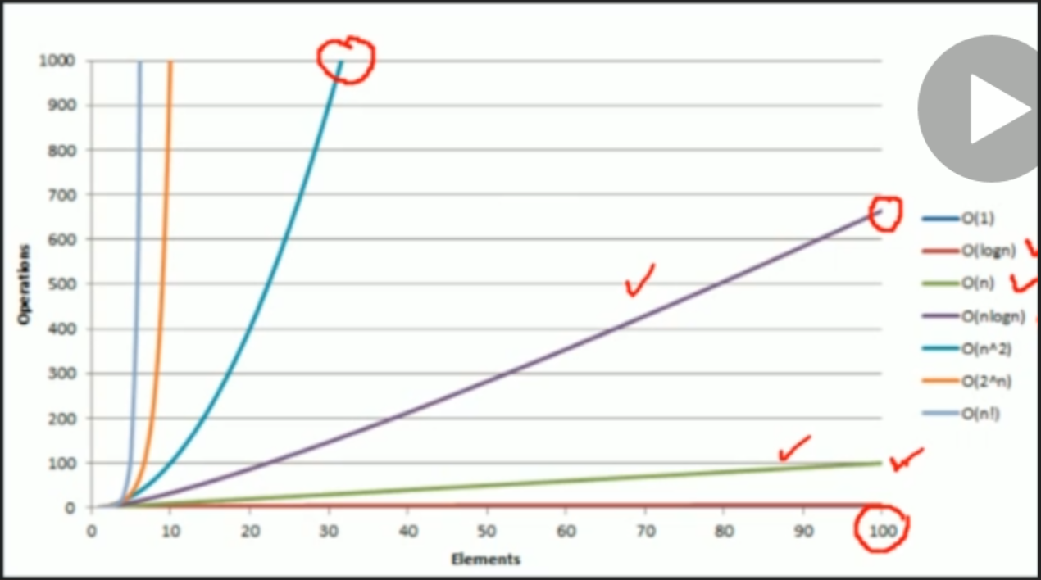
Examples of 'Algorithm run time complexities'

Slide 28
How to Calculate 'Algorithm Time Complexity'?
- Iterative Algorithm
- Recursive Algorithm

Slide 29
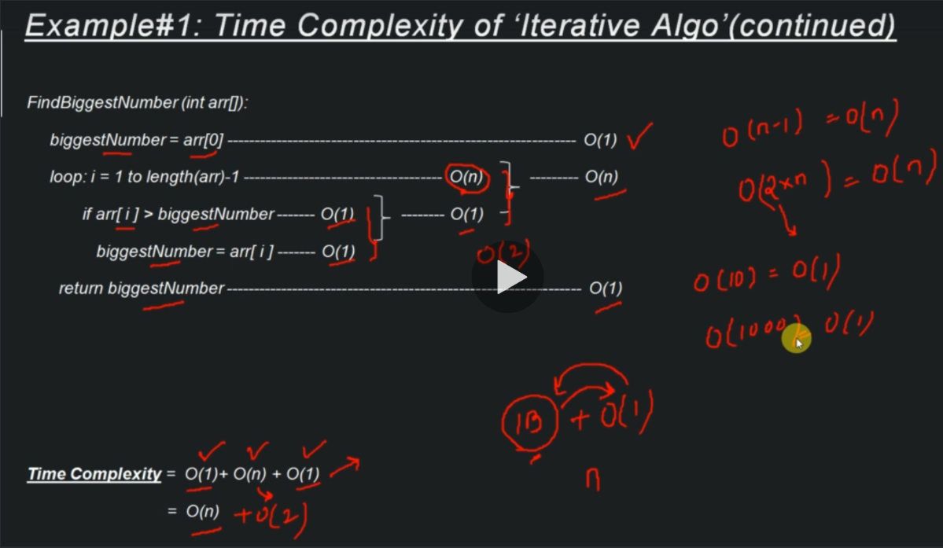
How to Calculate 'Algorithm Time Complexity'?

Slide 30
Data Structure Algorithms
Section 3 - Array

Slide 31
What is an Array?
- Observations from above Picture:
- All the compartments are contiguous.
- Each compartment can be identified uniquely.
- Size of the box is fixed and cannot (as they come from standard manufactures)
Properties of Array:
- Array can store data of specified data type.
- It has contiguous memory location.
- Every 'cell' of an Array has an unique 'Index'.
- 'Index' starts with 0.
- 'Size of Array' needs to be specified mandatorily and can not be modified.

Slide 32
What is an Array?
Definition of Array:
- Array is a data structure consisting of a collection of elements, each
identified by array index. An array is stored such that the position of each
element can be computed from its index cell by a mathematical formula.

Slide 33
Why do we need an Array?
Problem Statement: We want to store 1 million similar data types in memory.
Solution#1:
- We declare 1 million Primitive Data Structure like Integer, Float, Character,
Boolean.
- Problem: How will we maintain such a huge list of variables?
Solution#2:
- We declare an array of size 1 million.
- Advanced: We just need to reference the cell number of the array and we can
access that cell.

Slide 34
Types of Array?
- One Dimensional Array: In it each element is represented by a single subscript.
The elements are stored in consecutive memory locations. Ex: Arr[7], Arr[col]
|10|20|30|40|50|60|70|
- Multi Dimensional Array:
- Two dimensional array: In it each element is represented by two subscription.
Thus a two dimensional m x n array A has m rows and n columns and contains m*n
elements. Ex: Arr[3][7] has 3 rows and 7 columns and 2*3 = 6 elements. Arr[row][col]
| 10 | 20 | 30| 40| 50| 60| 70|
| 100 | 200 | 300| 400| 500| 600| 700|
|1000|2000|3000|4000|5000|6000|7000|

Slide 35
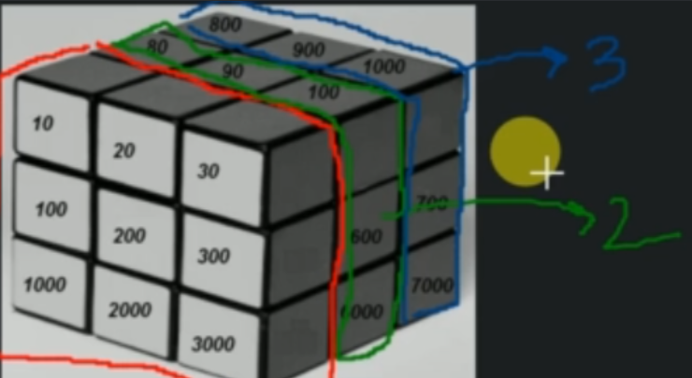
Types of Array?
- Three dimensional array: In it each element is represented by three subscription.
Thus a three dimensional m x n x l array A contains m*n*l elements. E.g. A[3][3][3]
has 3*3*3 = 27 elements. Arr[depth][row][col]
Example: MagicCube.PNG

Slide 36
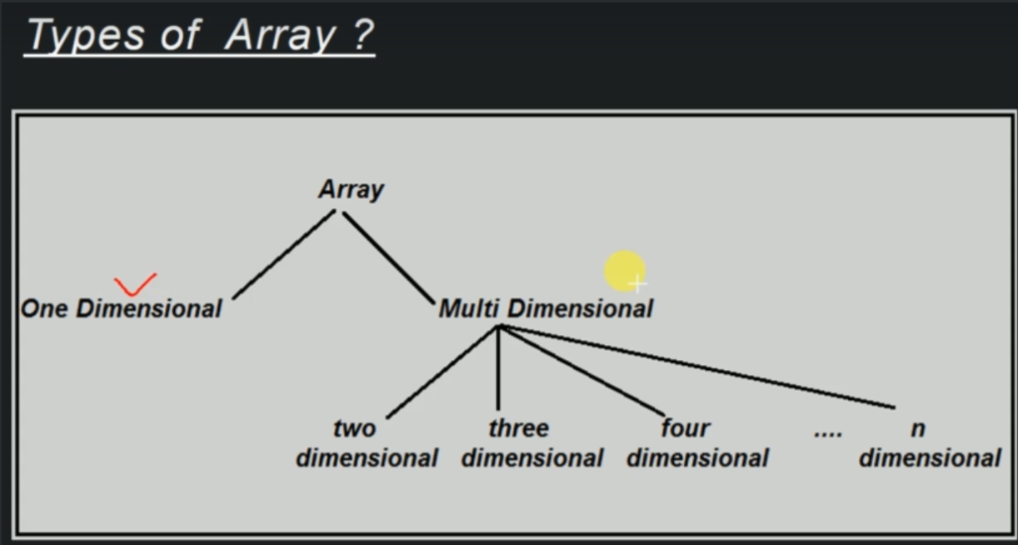
Types of Array?

Slide 37
How is an Array represented in Memory?
- 1D Array:
- Arr[col]
- Arr[10]={0, 1, 2, 3, 4, 5, 6, 7, 8, 9};
- Storage in RAM: |0|1|2|3|4|5|6|7|8|9|

Slide 38
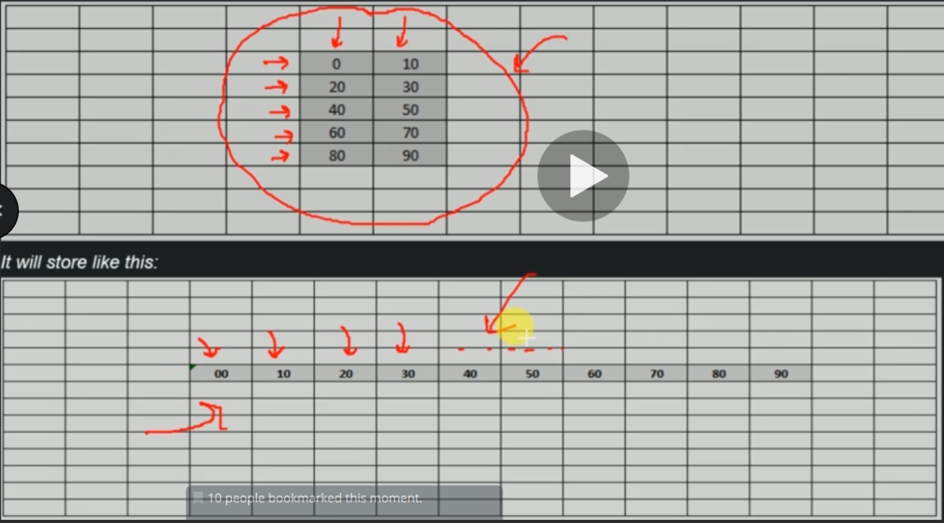
How is an Array represented in Memory?

Slide 39
How is an Array represented in Memory?

Slide 40
Common Operations of an Array:
- Declaring, Instantiating, Initializing and Array.
- Inserting a value
- Traversing a given Array
- Accessing given cell#
- Searching a given value
Deleting a given value
Declaring, Instantiating, Initializing and Array.
Declare: Creates a reference to Array - Just the name of array.
Instantiation of an Array: Creates a Array - Compiler allocate memory for the array.
Initialization: Assigns values to cells in Array

Slide 41
Common Operations of an Array:
Declaring, Instantiating, Initializing a 1D Array:
- Declare
- dataType[] arr
- Example: int[] arr
- Instantiation of an Array:
- arrayRefVar = new datatype[size];
- Example: arr = new int[5];

Slide 42
Inserting a value in 1D Array
insert(arr, valueToBeInserted, location):
if (arr[location] is occupied)
return error //location is already occupied
else
arr[location] = valueToBeInserted
Traversing a given 1D Array:
| 10 | 20 | 30 | 40 | 50 |
TraverseArray(arr):
loop: i = 0 to arr.length
print arr[i]

Slide 43
Inserting a value in 1D Array
Time Complexity - Traversing a given 1D Array:
Big-o(O) Notation
TraverseArray(arr):
loop: i = o to arr.length -------------------------- O(n)
print arr[i] -------------------------------- O(1)
Total Time Complexity - O(n)
Space Complexity ------ O(1)

Slide 44
Inserting a value in 1D Array
Deleting a given value from 1D Array:
| 10 | 20 | 30 | 40 | 50 | -2^31 | -2^31 |
Note: Positions in Arrays always have a value even tought they don't have a
value put for us. The default value is Integer.minValue(-2^31)
DeletingValueFromArray(arr, location):
if(arr[location] is occupied)
arr[location] = Integer.minValue
else
return // location is already blank

Slide 45
Inserting a value in 1D Array
Time Complexity - Deleting a given value from 1D Array:
DeletingValueFromArray(arr, location):
if(arr[location] is occupied) ----------------------------------------- O(1)
arr[location] = Integer.minValue ---------------------------------- O(1)
else ------------------------------------------------------------------ O(1)
return // location is already blank ------------------------------- O(1)
Total Time Complexity = O(1)
Space Complexity - O(1)

Slide 46
Accessing given cell# of 1D Array:
| 10 | 20 | 30 | 40 | 50 | | |
AccessingCell(arr, cellNumber):
if(cellNumber > sizeof(arr))
return exception //cell number cannot be bigger than size of Array.
else
return arr[cellNumber]

Slide 47
Time Complexity - Accessing given cell# of 1D Array:
AccessingCell(arr, cellNumber):---------------------------------------------------- O(1)
if(cellNumber > sizeof(arr)) ---------------------------------------------------- O(1)
return exception //cell number cannot be bigger than size of Array. --------- O(1)
else ---------------------------------------------------------------------------- O(1)
return arr[cellNumber] ------------------------------------------------------ O(1)
Total Time Complexity = O(1)
Space Complexity - O(1)

Slide 48
Searching a given value in 1D Array:
| 10 | 20 | 30 | 40 | 50 | | |
SearchInAnArray(arr, valueToSearch):
loop: i = 0 to arr.length
if( arr[i] equals valueToSearch)
return i
return error // value not found

Slide 49
Time Complexity - Searching a given value in 1D Array:
SearchInAnArray(arr, valueToSearch): -------------------------------- O(n)
loop: i = 0 to arr.length ----------------------------------------- O(1)
if( arr[i] equals valueToSearch) -------------------------------- O(1)
return i ----------------------------------------------------- O(1)
return error // value not found --------------------------------- O(1)
Total Time Complexity - O(n)
Space Complexity - O(1)

Slide 50
Time/Space Complexity of 1D Array:
Particulars | Time Complexity | Space Complexity |
Creating an empty Arrays | O(1) | O(n) |
Inserting a value in an Array | O(1) | O(1) |
Traversing a given Array | O(n) | O(1) |
Accessing given cell# | O(1) | O(1) |
Searching a given value | O(n) | O(1) |
Deleting a given value | O(1) | O(1) |

Slide 51
Inserting a value in 2D Array:
Insert(arr, valueToBeInserted, rowNumber, colNumber):
if (arr[rowNumber][colNumber] is occupied)
return error // location is already
else
arr[rowNumber][colNumber] = valueToBeInserted

Slide 52
Time Complexity - Inserting a value in 2D Array:
Insert(arr, valueToBeInserted, rowNumber, colNumber):
if (arr[rowNumber][colNumber] is occupied) ------------------------- O(1)
return error // location is already ------------------------------ O(1)
else -------------------------------------------------------------- O(1)
arr[rowNumber][colNumber] = valueToBeInserted -------------------- O(1)

Slide 53
Time Complexity - Inserting a value in 2D Array:
Insert(arr, valueToBeInserted, rowNumber, colNumber):
if (arr[rowNumber][colNumber] is occupied) ------------------------- O(1)
return error // location is already ------------------------------ O(1)
else -------------------------------------------------------------- O(1)
arr[rowNumber][colNumber] = valueToBeInserted -------------------- O(1)
Time Complexity = O(1)
Space Complexity = O(1)

Slide 54
Traversing a given 2D Array
TraverseArray(arr):
loop:row = o to rows
loop: col = o to col
print arr[row][col]

Slide 55
Time Complexity - Traversing a given 2D Array:
TraverseArray(arr):
loop:row = o to rows --------------------- O(m)
loop: col = o to col ------------------- O(n)
print arr[row][col] ------------------ O(n)
Time Complexity = O(mn) Note: m means quantity of rows
Space Complexity = O(1)

Slide 56
Accessing given cell's value of 2D Array:
AccessingCell(arr, rowNumber, colNumber):
return arr[rowNumber][colNumber]

Slide 57
Time Complexity - Accessing given cell's value of 2D Array:
AccessingCell(arr, rowNumber, colNumber):
return arr[rowNumber][colNumber] --------------- O(1)
Time Complexity = O(1)
Space Complexity = O(1)

Slide 58
Searching a given value in 2D Array:
SearchingAnArray(arr, valueToSearch):
loop: row = o to rows
loop: col = o to col
if(arr[row][col] equals valueToSearch)
print (row, col); return
print (value not found)

Slide 59
Time Complexity - Searching a given value in 2D Array:
SearchingAnArray(arr, valueToSearch):
loop: row = o to rows ------------------------------------------------ O(m)
loop: col = o to col ------------------------------------------------ O(n)
if(arr[row][col] equals valueToSearch) ---------------------------- O(1)
print (row, col); return ---------------------------------------- O(1)
print (value not found) --------------------------------------------- O(1)
Time Complexity = O(mn)
Space Complexity = O(1)

Slide 60
Deleting a given cell's value from 2D Array.
DeletingValueFromArray(arr, rowNumber, colNumber):
arr[rowNumber][colNumber] = Integer.Min_Value

Slide 61
Time Complexity - Deleting a given cell's value from 2D Array:
DeletingValueFromArray(arr, rowNumber, colNumber):
arr[rowNumber][colNumber] = Integer.Min_Value ----------------------- O(1)
Time Complexity = O(1)
Space Complexity = O(1)

Slide 62
Declaring, Instantiating, Initializing a 2D Array:
Declare:
- dataType[][] arr
- Example: int[][] arr
Instantiation of an Array:
- arrayRefVar = new datatype[row][col];
- Example: arr = new[2][3]

Slide 63
Declaring, Instantiating, Initializing a 2D Array:
Initialization:
- a[0][0]=10
- a[0][1]=20
- a[0][2]=30
- a[1][0]=40
- a[1][1]=50
a[1][2]=60
Declaration, Instantiation and initialization:
- int[][]arr = {{10,20,30},{40,50,60}};

Slide 64
Declaring, Instantiating, Initializing a 2D Array:
Declaring, Instantiating, Initializing a 2D Array:
Declare:
- dataType[][] arr ---------------------------------------------------- O(1)
- Example: int[][] arr
Instantiation of an Array:
- arrayRefVar = new datatype[row][col]; --------------------------------- O(1)
- Example: arr = new[2][3]

Slide 65
Declaring, Instantiating, Initializing a 2D Array:
Initialization:
- a[0][0]=10 |
- a[0][1]=20 |
- a[0][2]=30 |------------------------------------------------------- O(mn)
- a[1][0]=40 |
- a[1][1]=50 |
- a[1][2]=60 |
Declaration, Instantiation and initialization:
- int[][]arr = {{10,20,30},{40,50,60}}; ---------------------------------- O(1)

Slide 66
Time/Space Complexity of 2D Array::
Particulars | Time Complexity | Space Complexity |
Creating an Array | O(1) | O(mn) |
Inserting a value | O(1) | O(1) |
Traversing given Array | O(mn) | O(1) |
Accessing given Cell# | O(1) | O(1) |
Searching a given value | O(mn) | O(1) |
Deleting a given cell's value | O(1) | O(1) |

Slide 67
When to Use/Avoid Array
When to use:
- When there is a need to store multiple similar type of data.
- When random access is regular affair.
When to Avoid:
- Data to be stored are non-homogenous
- When number of data to be stored is not known in advance.

